Slide 1
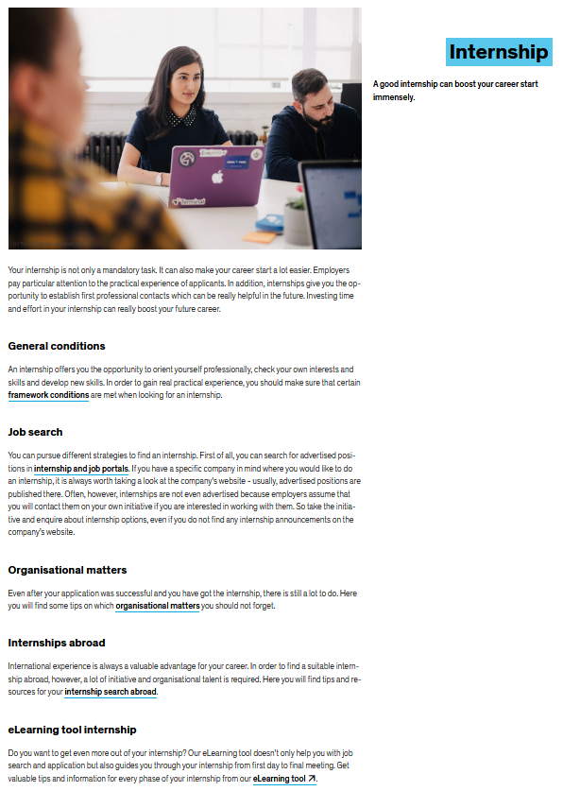
Career Service
Counselling and support with
Career orientation
Internship
Starting a career
Job applications
e.g.
Individual counselling
Lectures, workshops, application training
Internship and job portal in ZEuS
Application documents check
LinkedIn profile check
eLearning tool Internship
Career day kontaktpunkt
and much more ...
→ all info on uni.kn/career-service

